Slide 1



Comparing the Impact of Online and In-person Consultations
2303-Capstone-Group-B
Notes:
More funky title

Slide 2






MEET THE GROUP
(Data Mavericks)
Muhammad Talha (Team Lead)
Umaima Siddiqui
Syed Muhammad Raqim Ali Shah
Mohammad Hussam
Huzaifa Ali

Slide 3

Problem Statement
Patient travel for appointments results in inconvenience, time wastage, fuel expenses, and harmful greenhouse gases emission.

Slide 4


Our Solution
Implemented an efficient and user-friendly online appointment system, which will solve the following;
Eliminating
unnecessary travel
Reducing commute time
Avoiding emission of gases
Saving money

Slide 5


Approach
Retrieve the location of a patient and a councillor using their respective IDs.
Utilize an external API to determine the distance and travel time between the two locations.
Extract the country from the patient's location information.
Obtain the currency and fuel price information corresponding to the country.
Temporarily store the fuel price and currency in Redis.
Calculate the emissions of gases and the total cost saved based on the retrieved data.
Notes:
Add hier and bar charts
Image bank
Blank slide w/ header & footer

Slide 6
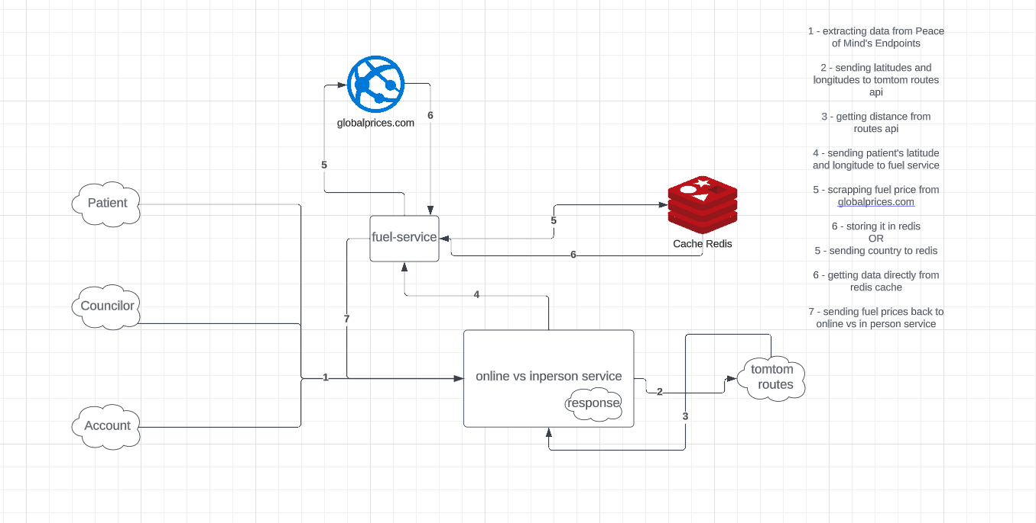
Architecture

Slide 7

Methodology
The methodology involves extracting relevant data, calculating prices based on location and distance, and providing a comprehensive comparison between online and in-person appointments.

Slide 8


Challenge Faced
In our search for an external API to extract fuel prices based on country, we found that all available APIs requires payment.
As an alternative, we opted to scrap the fuel prices directly from the website globalpetrolprices.com.

Slide 9

Findings
In our attempt to update the fuel price every 24 hours using a cronjob, we find out a more efficient solution.
Consequently, we employed the redis.expire() function to automatically delete the relevant data stored in Redis after a 24-hour period.

Slide 10






TECH STACK
Language (Python)
Web Framework (FastApi)
Caching Data (Redis)
Containerization (Docker)
Version Controlling (Git)

Slide 11
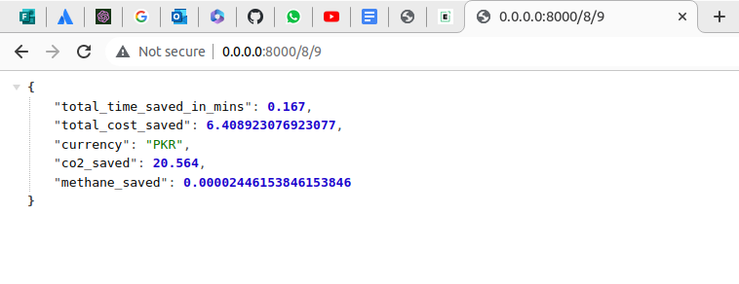
Result

Slide 12
References
https://snyk.io/advisor/python/geopy/functions/geopy.geocoders.Nominatim
https://www.crummy.com/software/BeautifulSoup/bs4/doc/
https://chat.openai.com/
https://stackoverflow.com/
https://developer.tomtom.com/

Slide 13


